Slide 1
Lecture 5+ - Review
Programming
Principles and Practice Using C++
Shengfa Wang
sfwang@dlut.edu.cn

Slide 2
Words
Watch your thoughts,
they become words;
Watch your words,
they become actions;
Watch your actions,
they become habits;
Watch your habits,
they become character;
Watch your character,
it becomes your destiny.
Notes:
郭靖天资不聪明，有点笨，但是没关系，他有良好的态度。对待自己的笨，打小他就不当回事，认真练功。江南七怪都看不下去了，他依然练，后来遇到马玉点拨一番，武功突飞猛进。这是良好态度给他的第一个礼物。凭借着低调，勤奋，抓住每一个机会，让自己一点点的成长起来，别人热闹，别人瞧不起，都没关系，我就低着头走我的路。这是什么，这不是傻，这是意志，
欧阳克和杨康有很多共同的地方，都是官二代，都有良好的小学、中学、大学教育，都取得了良好的成绩，有良好的学历。都有很好的资质，隐然一副接班人的架势，并且所属势力都不宜余力的给与支持，这是硬件。看看他们出场时的态度，目的性极强，方法极端，功利性极强，这种态度和郭靖的不计结果是一种鲜明的对比，态度决定人生。

Slide 3
Review
C++ programming
Function
Class

Slide 4
Key Ideas of OOP
(Abstraction)
  Data abstraction is a programming (and design) technique that relies on the separation of interface and implementation.
Encapsulation
  Encapsulation is a term that describes the technique of combining lower-level elements to form a new, higher-level entity.
Inheritance
  Inheritance lets us define classes that model relationships among types, sharing what is common and specializing only that which is inherently different.
Polymorphism
  Polymorphisms means the ability to request that the same operations be performed by a wide range of different types of things.
  polymorphisms is achieved by using many different techniques named function overloading, operator overloading and function overriding

Slide 5
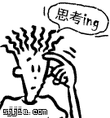
Compute the distance between two points
class Point
{
public:
double distance(Point & p) {
return sqrt((p.x-x)*(p.x-
x)+(p.y-y)*(p.y-y)); }
void setX(double i){x=i;}
void setY(double j){y=j;}
private:
double x;
double y;
};
void main(){
Point p1,p2;
p1.setX(2);p1.setY(2);
p2.setX(5);p2.setY(6);
cout<<p1.distance(p2);
}
reference in distance？
Other distance(*,*)？

Slide 6
Compute the distance between two points
//Head file
//point.h
class Point
{
public:
double distance(Point & p);
void setX(double i);
void setY(double j);
private:
double x;
double y;
};
//source file
//point.cpp
#include<iostream>
#include<cmath>
#include"point.h"
using namespace std;
double Point::distance(Point & p)
{ return sqrt((p.x-x)*(p.x-x)+(p.y-y)*(p.y-y)); }
void Point::setX(double i){x=i;}
void Point::setY(double j){y=j;}

Slide 7
Compute the distance between two points
//Source file: to use the class
//main.cpp
#include<iostream>
#include<cmath>
#include"point.h"
using namespace std;
void main(){
Point p1,p2;
p1.setX(2);p1.setY(2);
p2.setX(5);p2.setY(6);
cout<<p1.distance(p2);
}

Slide 8
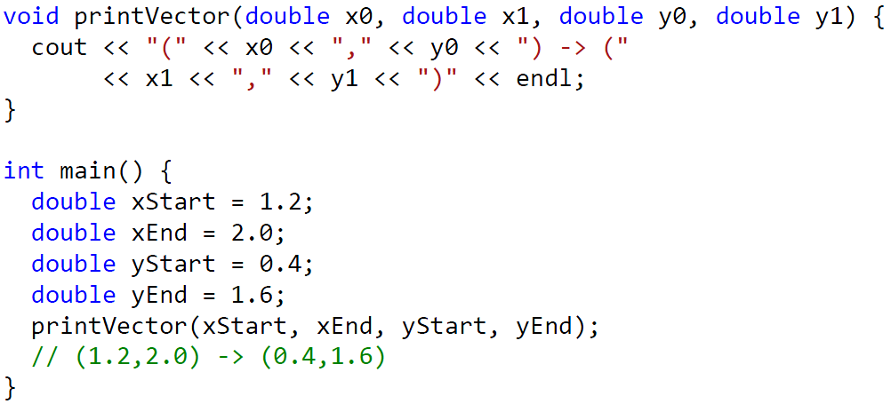
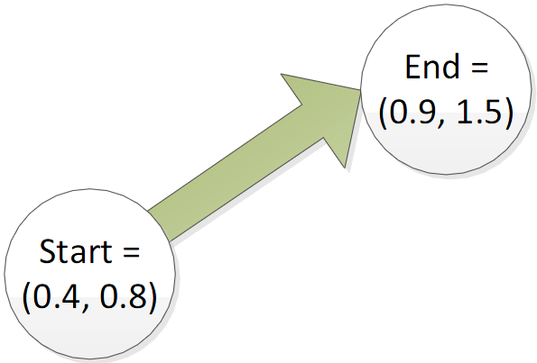
Representing a Vector
Vector: 2 points (a start & a finish)
Each point has an x and y coordinate

Slide 9
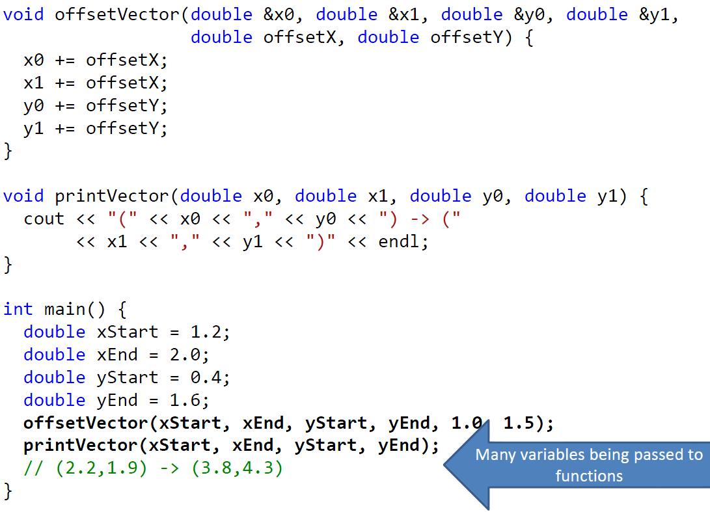


Slide 10
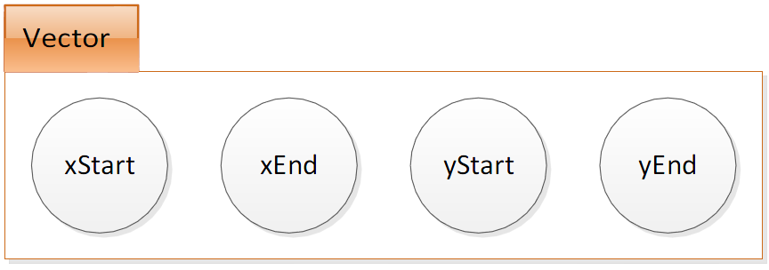
Class
A user-defined datatype which groups together related pieces of info.

Slide 11
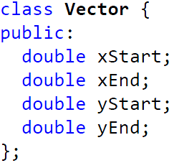
Class
Name: indicates the new datatype defined is called Vector
name

Slide 12
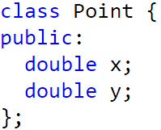
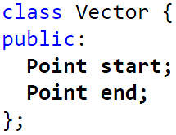
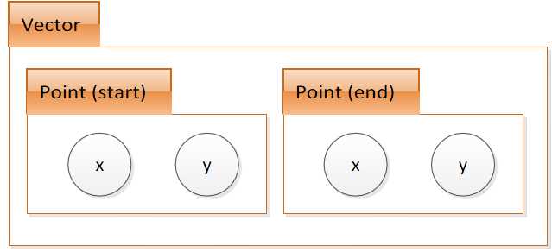
Class

Slide 13
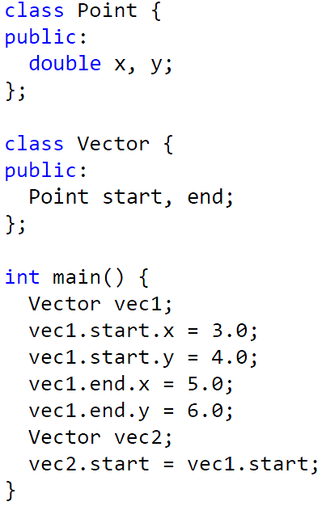
Class

Slide 14
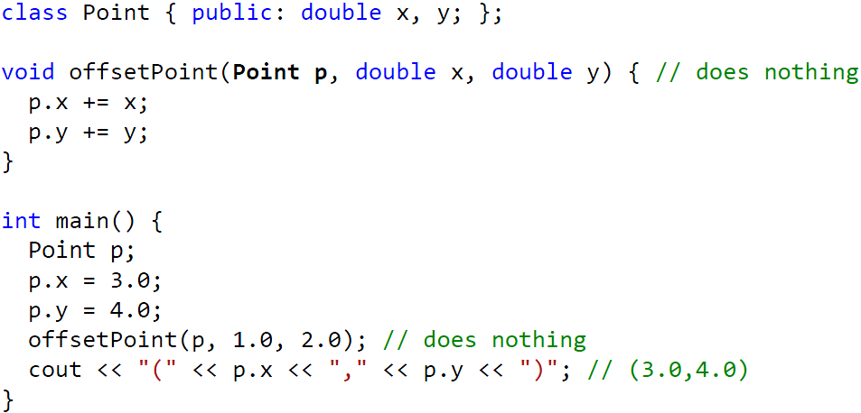
Passing classes to functions as values

Slide 15
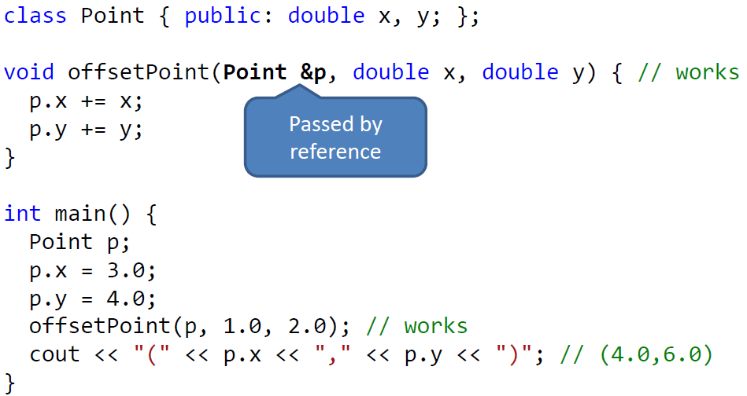
Passing classes to functions as references

Slide 16
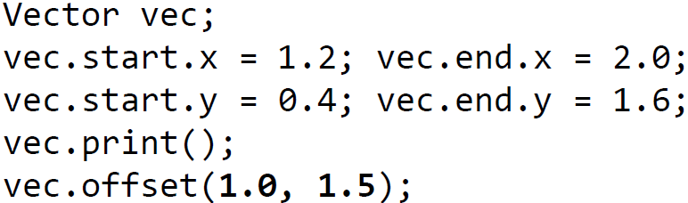
Functions
Functions which are part of a class
Object instance
Function
name

Slide 17
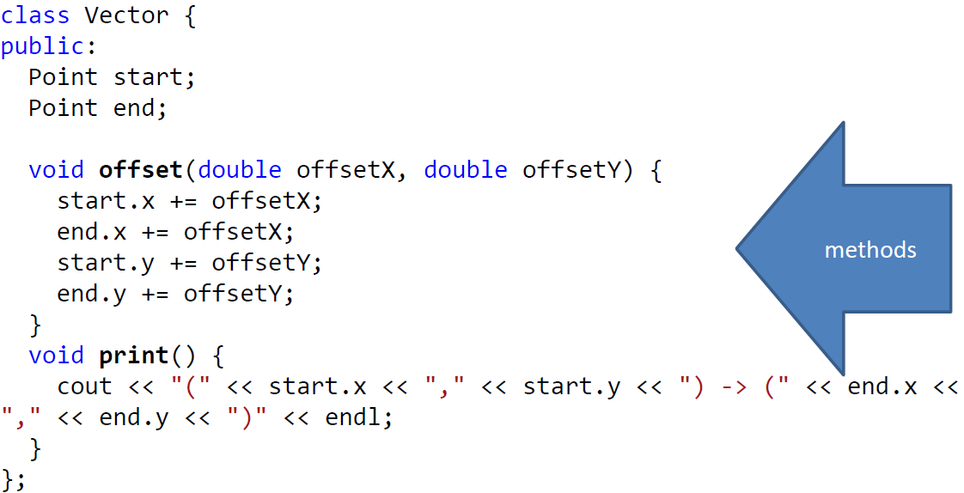
Functions
members can be accessed in a function

Slide 18
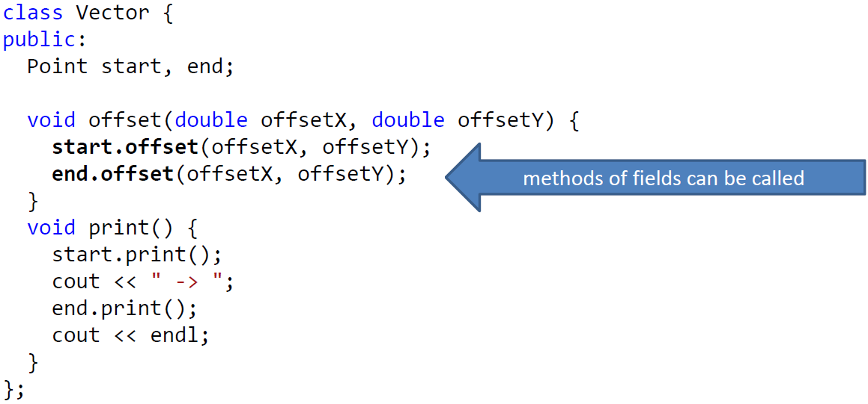
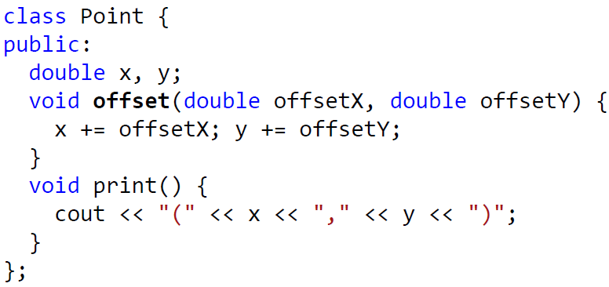

Slide 19
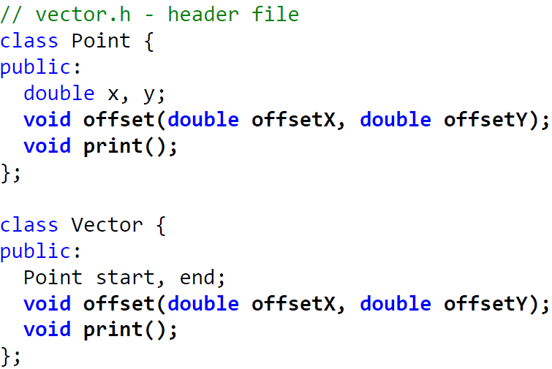
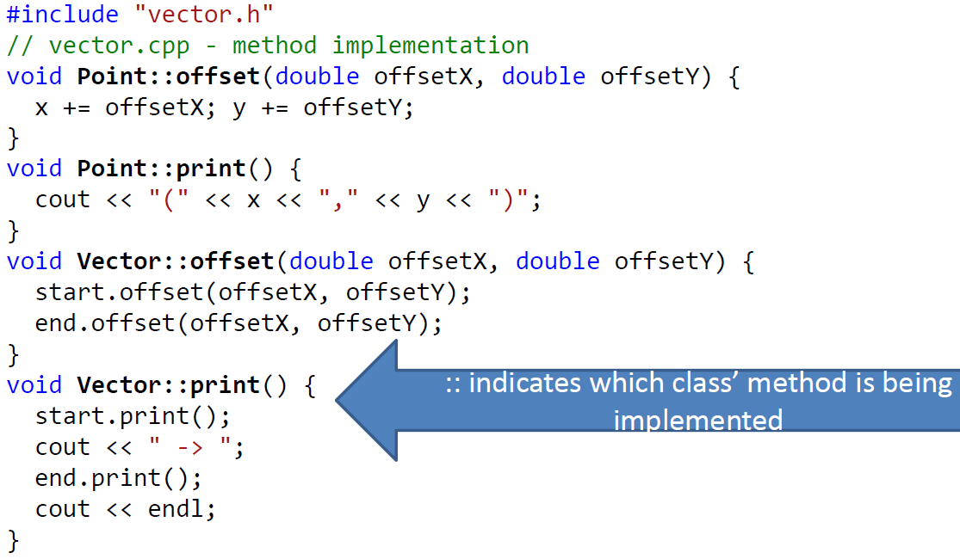
Implementing Methods Separately

Slide 20
Practice
Write your own class circle using the former classes (vector and point), design the functions of getCentre, getRadius, getArea, and output these values.
What else can we do to simplify our program?

Slide 21
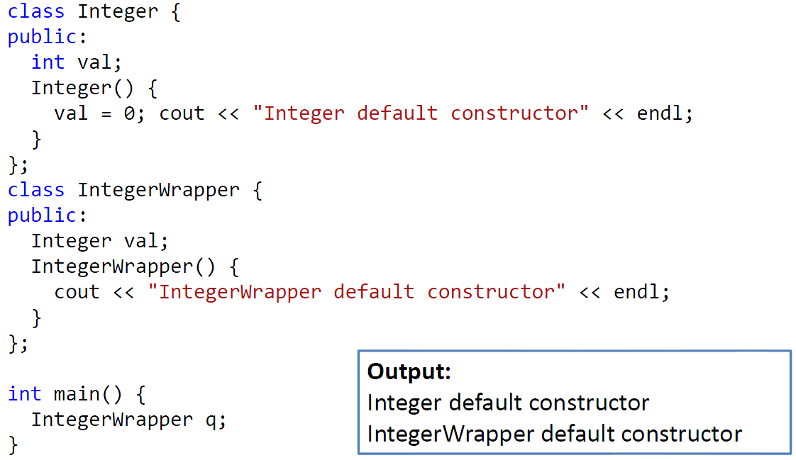

Constructors
When making a class instance, the default constructor of its fields are invoked

Slide 22
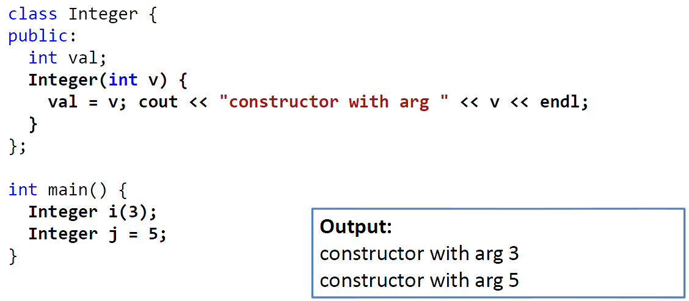
Constructors
Can accept parameters

Slide 23
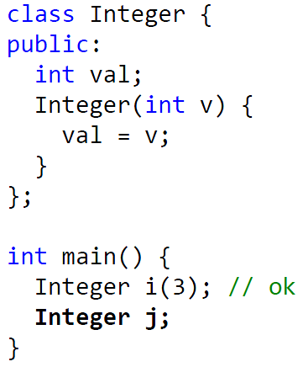
Constructors
If a constructor with parameters is defined, the default constructor is no longer available
// compiling failed

Slide 24
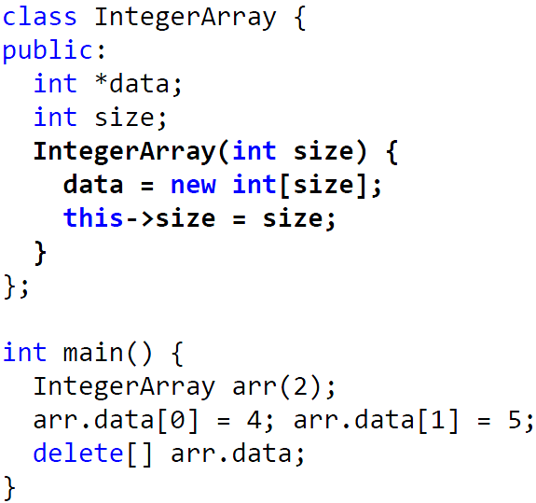
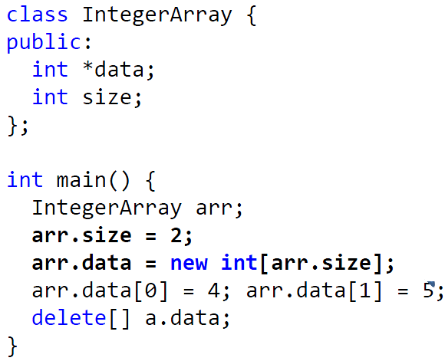
Constructor
Representing an Array of Integers

Slide 25
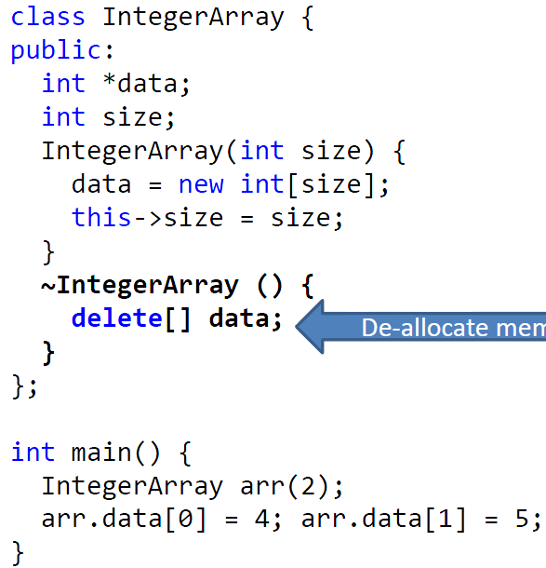
Encapsulation

Slide 26
Constructor and Destructor
class Point
{
private:
double x, y;
char *name;
public:
Point(char *n=Null, double x=0, double y=0);
~Point();
void disp( );
};
Point::Point (char *n, double a, double b) {
x = a; y = b;
if(n) {
name=new char[strlen(n)+1];
strcpy(name,n);
}
else{
name=new char[8];
strcpy(name,"no name");
}
cout<<name<<" constructing"<<endl;
}
Default parameter

Slide 27
Constructor and Destructor
Point::~Point(){
cout<<name<<" destructing"<<endl;
delete [] name;
}
void Point::disp( ){ cout<<name<<":"<<x<<","<<y<<endl; }
void main(){
Point p1("home",1.0,2.0);
Point p2(“school”, 1.0,2.0);
Point p3;
cout<<“p1=”;
p1.disp();
cout<<"p2=";
p2.disp();
cout<<"p3=";
p3.disp();
}
home constructing
school constructing
no name constructing
p1=home:1,2
p2=school:1,2
p3=no name:0,0
no name destructing
school destructing
home destructing

Slide 28
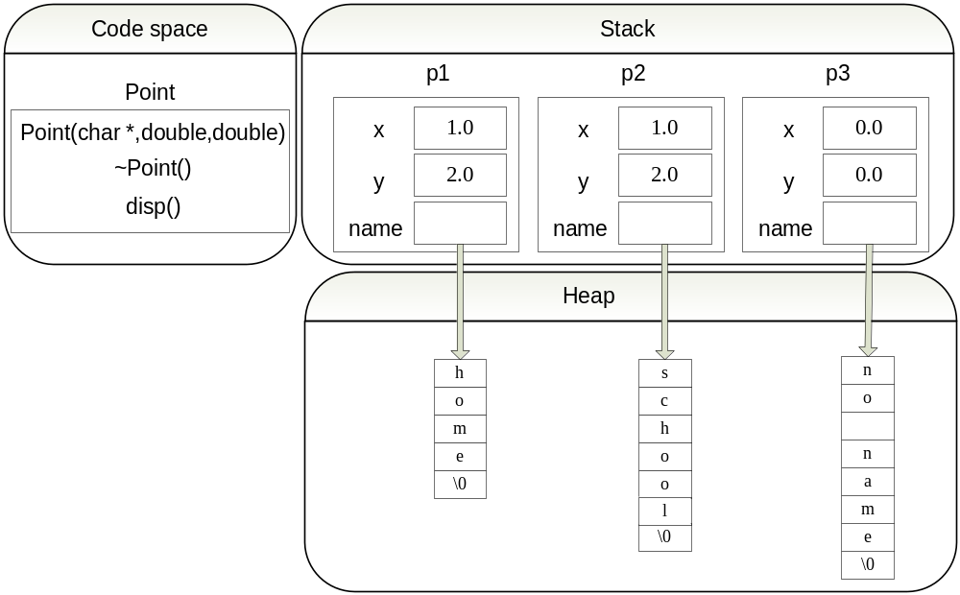
Constructor and Destructor
Point p1(“home”,1.0,2.0),p2(“school”, 1.0,2.0), p3;

Slide 29
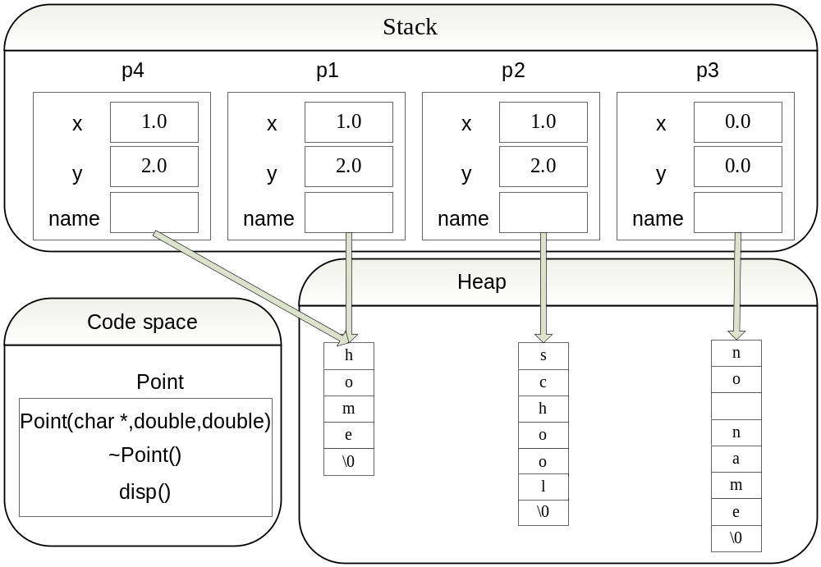
Constructor and Destructor
Point p1(“home”,1.0,2.0),p2(“school”, 1.0,2.0), p3;
Point p4=p1 ;
How to destructor？

Slide 30
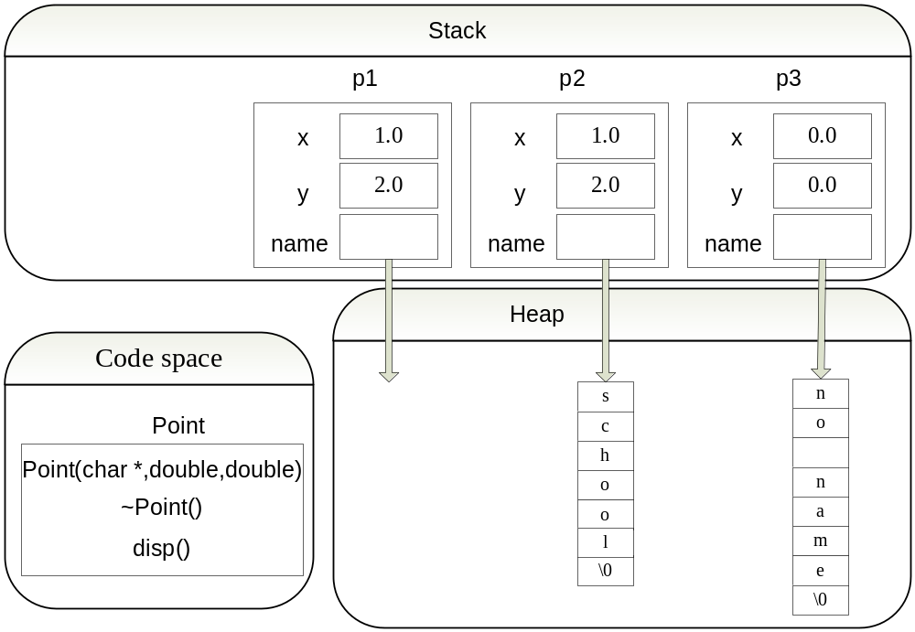
Constructor and Destructor
Point p1(“home”,1.0,2.0),p2(“school”, 1.0,2.0), p3;
Point p4=p1 ;
P4 Destructor

Slide 31
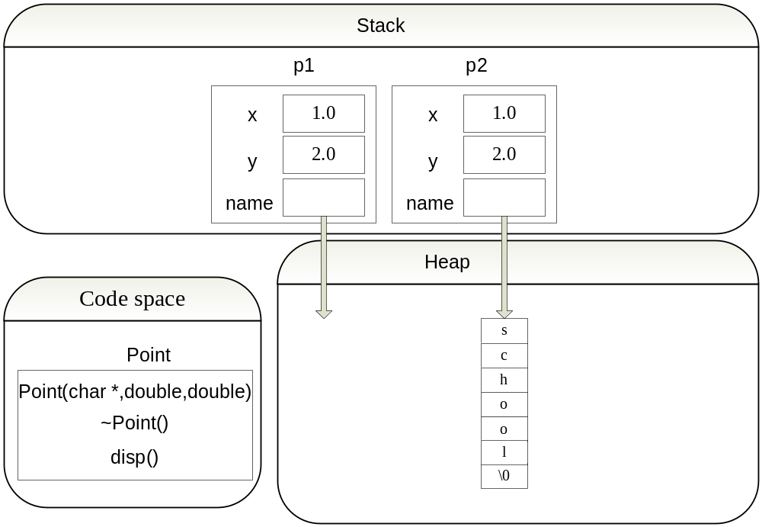
Constructor and Destructor
Point p1(“home”,1.0,2.0),p2(“school”, 1.0,2.0), p3;
Point p4=p1 ;
P3 Destructor

Slide 32
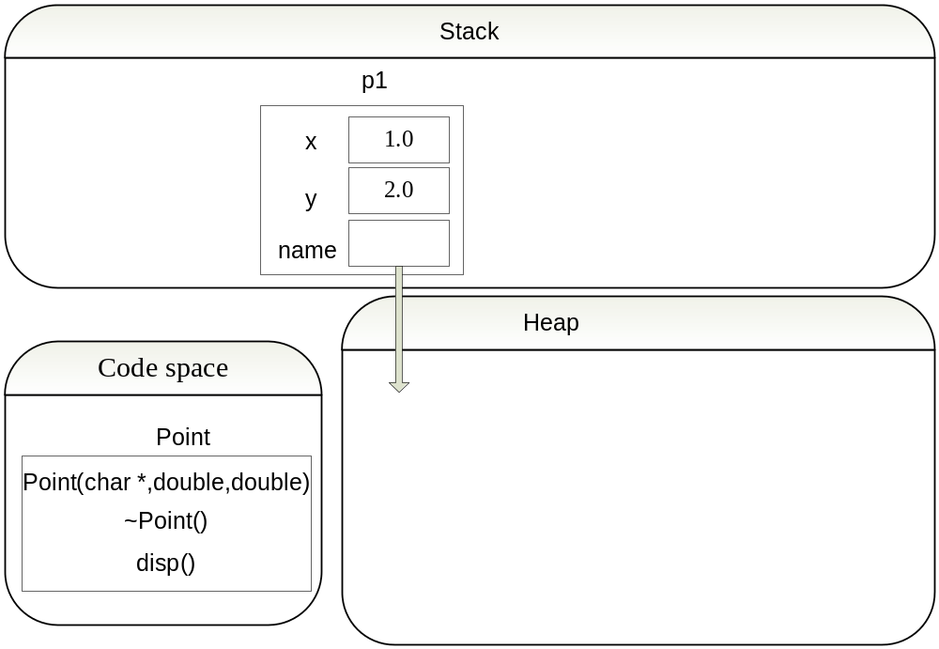
Constructor and Destructor
Point p1(“home”,1.0,2.0),p2(“school”, 1.0,2.0), p3;
Point p4=p1 ;
P2 Destructor

Slide 33
Constructor and Destructor
Point p1(“home”,1.0,2.0),p2(“school”, 1.0,2.0), p3;
Point p4=p1 ;
P1 Destructor?
Delete? Name?

Slide 34
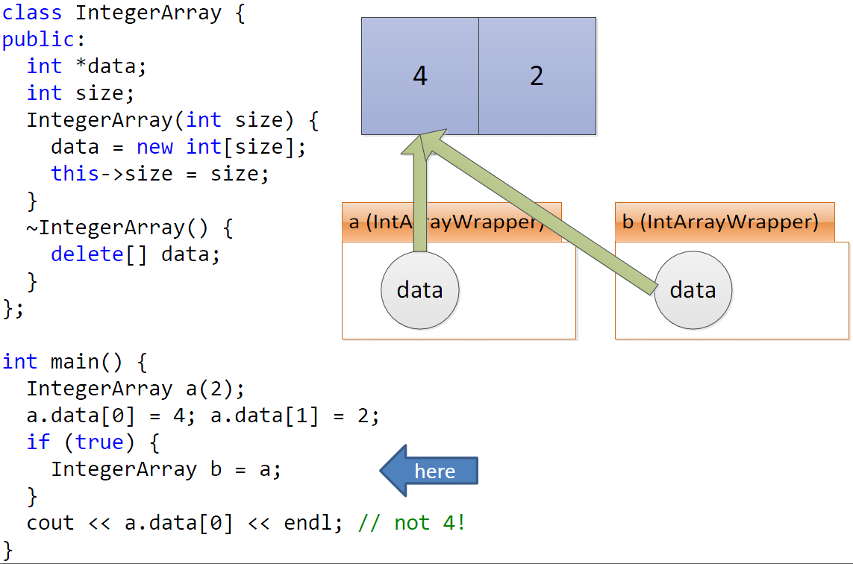
Default copy constructor copies fields

Slide 35
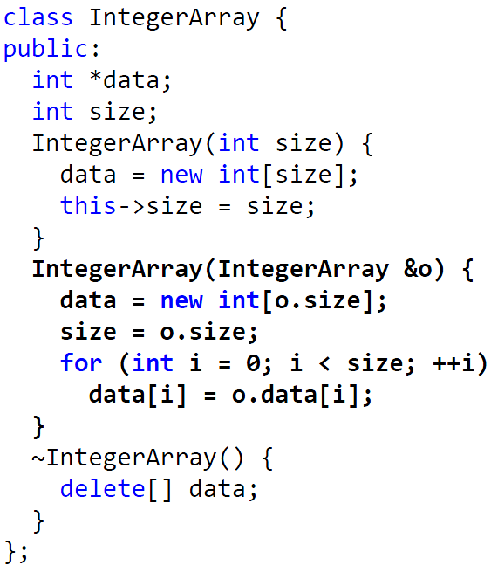
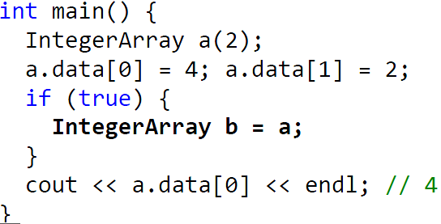
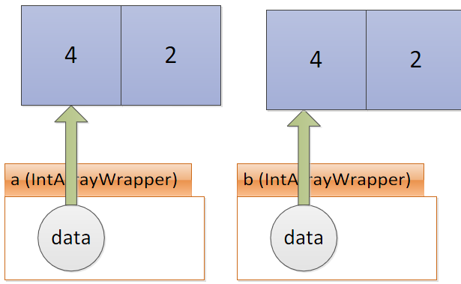
Copy Constructor

Slide 36
Copy Assignment?
& (const IntegerArray & o)
IntegerArray ________ operator = _______________
{
if (___________ )
{
if (name!= NULL)
{______________ }
this->id = str.id;
int len = strlen(str.name);
__________________________
strcpy_s(name, strlen(str.name) + 1, str.name);
}
return *this;
}
this != & o
delete [] name;
name = new char[len + 1];

Slide 37
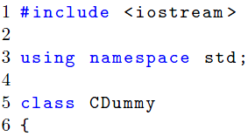
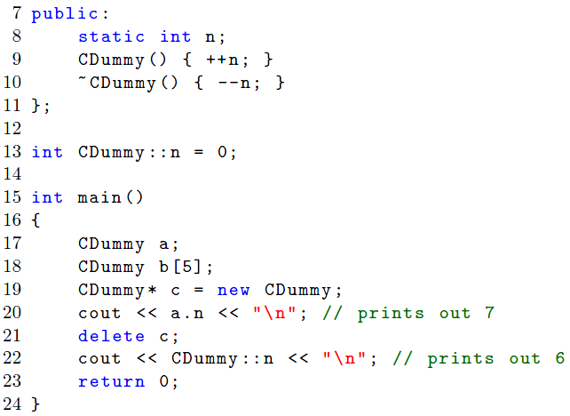
Static Members and Functions
“class variables”, shared for all the instances of that class.
Notes:
对于函数来讲，static的作用仅限于隐藏，而对于变量，static还有下面两个作用:保持变量内容的持久;默认初始化为0

Slide 38
Static Members and Functions
#include
class M{
public:
M(int a) { A=a; B+=a;}
static void f1(M m);
private:
int A;
static int B;
};
void M::f1(M m){
cout<<"A="<<M.A<<ENDL;
cout<<"B="<<B<<ENDL;
}
int M::B=0;
void main(){
M P(5),Q(10);
M::f1(P);
M::f1(Q);
}
A=5;
B=15;
A=10;
B=15;

Slide 39
Static Members and Functions
Compute the overall score and average
class Student{
private:
char name[20]; int age; float score;
public:
Student(char * n, int a, int s){
strcpy(name,n); age=a; score=s;
sum+=score; }
static float sum;
static float getAverage();
void display();};
float Student::getAverage(){return sum/3;} //do not need static
float Student::sum=0; //initialize
void Student::display(){ //function member use the static
cout<<"sum="<<sum<<" average="<<getAverage()<<endl;}

Slide 40
Static Function
Compute the overall score and average
sum=0 average=0
sum=208 average=69.3333
sum=208 average=69.3333
；
int main()
{
cout<<“sum=”<<Student::sum<<“average=”<<Student::getAverage()<<endl;
Student stud[3]={ Student(“zhang san”,20,60), Student(“Li si”,19,70), Student(“Wang wu”,18,78) };
cout<<“sum=”<<Student::sum<<“average=”<<Student::getAverage()<<endl;
stud[0].display();
return 0;
}
class Student{
public:
Student(char * n, int a, int s){strcpy(name,n); age=a; score=s; sum+=score; }
static float sum;
static float getAverage();
void display();};
float Student::getAverage(){return sum/3;}
float Student::sum=0;
void Student::display(){ cout<<"sum="<<sum<<" average="<<getAverage()<<endl;}

Slide 41
Summary
Persistence: it remains in memory until the end of the program.
File scope: it can be seen only within a file where it's defined.
Visibility: if it is defined within a function/block, it's scope is limited to the function/block. It cannot be accessed outside of the function/block.
Class: static members exist as members of the class rather than as an instance in each object of the class. So, this keyword is not available in a static member function. Such functions may access only static data members.
A static data member : class variable
A non-static data member : instance variable
Static member function: it can only access static member data, or other static member functions while non-static member functions can access all data members of the class: static and non-static.
Notes:
你可以考虑一下，一个班内有50个学生，编号1~50。这是唯一的.
但是对一个校长来说，学号25对他来说是没意义的，除非加上班级的限制。
但是对每一个学生来说，校长是没有歧义的，唯一的。
static int sgetValue(Something &a) { a.w; } // static member function

Slide 42
Const class objects and member functions
Const classes
  Instantiated class objects can also be made const by using the const keyword. Initialization is done via class constructors
  const Date date1; // initialize using default constructor
  const Date date2(2020, 10, 16); // initialize using parameterized constructor
  (Once a const class object has been initialized via constructor, any attempt to modify the member variables of the object is disallowed)
Const member functions
  It turns out that const class objects can only explicitly call const member functions
  getValue() has to be marked as a const member function
int getValue() const { return m_value; }

Slide 43
Friend functions
    class Accumulator{
    private:
    int m_value;
    public:
    Accumulator() { m_value = 0; }
    void add(int value) { m_value += value; }
    // Make the reset() function a friend of this class
    friend void reset(Accumulator &accumulator);
    };
    //Note: no Accumulator::, reset() is now a friend of Accumulator
    void reset(Accumulator &accumulator){
    accumulator.m_value = 0;
    }

Slide 44
Friend class
#include<iostream>
using namespace std;
class A{
private: int x;
Public: A(){x=1;}
};
class B{
Private: char c;
Public: B() {c='c';}
void something(){
A instance;
cout<<instance.x<<endl;
}
};
int main(){
B b_instance;
b_instance.something();
return 0;
}
friend class B;

Slide 45
Friend in operator overloading
// "a<b" three overloading methods
//作为友元函数重载 (推荐)
class Person{
string name;
int age;
public:
Person(const char* name, int age){}
friend bool operator<(const Person& a,const Person& b);
};
bool operator<(const Person& a,const Person& b)
{
...
}
/作为成员函数重载（改变参数个数）
class Person{
string name;
int age;
public:
Person(const char* name, int age){...}
bool operator<(const Person& b);
};
bool Person::operator<(const Person& b)
{
//作为成员函数时，*this即为左操作数a
}
/作为普通函数重载（不推荐）
class Person{
public://注意，重载运算符为普通函数时，使用到的类成员必须为public
string name;
int age;
public:
Person(const char* name, int age){...}
};
bool operator<(const Person& a,const Person& b)
{ ... }

Slide 46
Friend in operator overloading
ostream/instream should be friend and &
/作为成员函数重载（改变参数个数）
class Person{
string name;
int age;
public:
Person(const char* name, int age){...}
bool operator<(const Person& b);
};
bool Person::operator<(const Person& b)
{
//作为成员函数时，*this即为左操作数a
}
friend ostream & operator<<(ostream &out, const Person& b)
{
out << b.* << " " << b.*;
return out;
}
the left operator must be ostream, but not this!
the ostream is not allowed to copy ( the copy constructor and assigment is decleared in protected)
//if operator << is a member function
ostream & operator<<(ostream &out)
{
out << this->* << " " << ...;
return out;
}
object << cout; //if operator << is a member function。

Slide 47
Questions?

